Slide 1
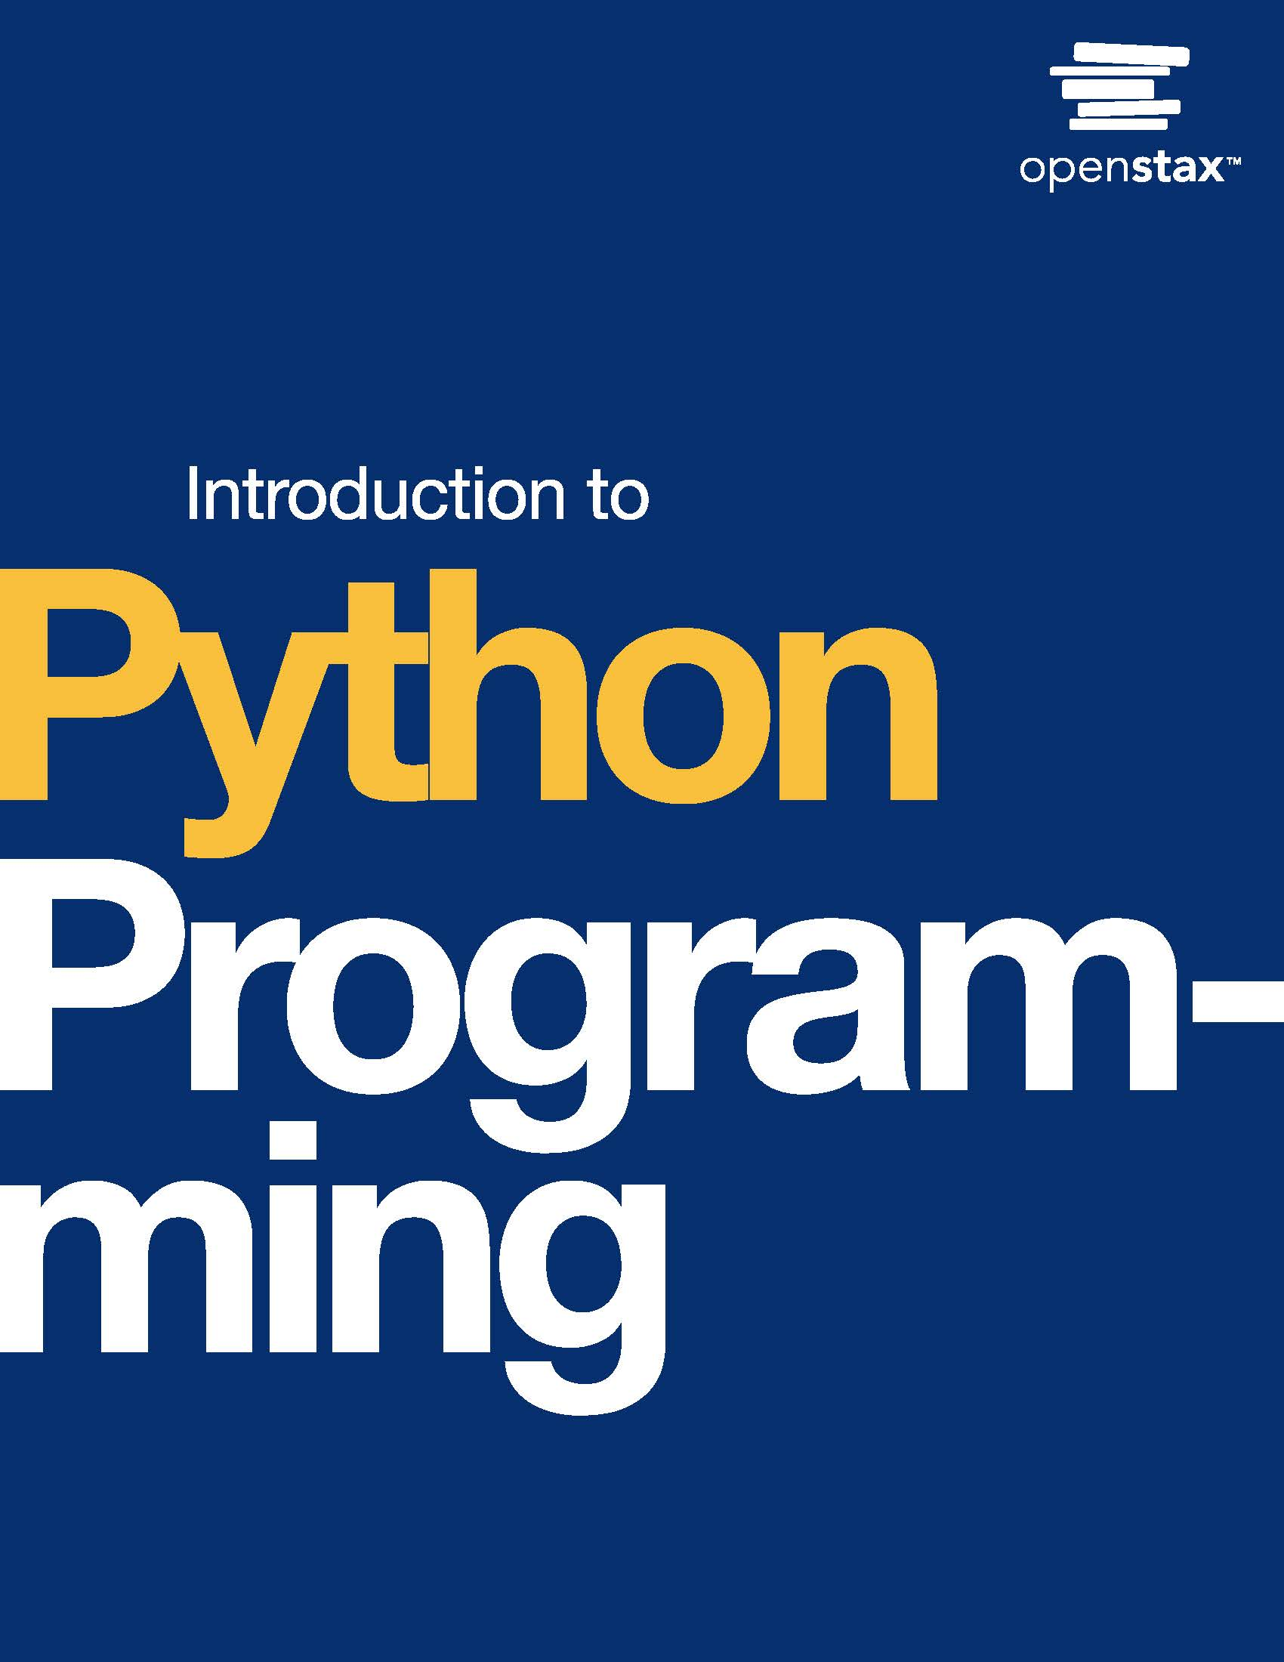
Introduction to Python Programming
Chapter 11: Classes

Slide 2
Chapter outline
Object-oriented programming basics
Classes and instances
Instance methods
Overloading operators
Using modules with classes

Slide 3
11.1 Object-oriented programming basics
Learning Objectives
Describe the paradigm of object-oriented programming (OOP).
Describe the concepts of encapsulation and abstraction as they relate to OOP, and identify the value of each concept.

Slide 4
11.1 Object-oriented programming basics
Grouping into objects
Object-oriented programming (OOP) is a style of programming that groups related fields, or data members, and procedures into objects.
Real-world entities are modeled as individual objects that interact with each other.
Ex: A social media account can follow other accounts, and accounts can send messages to each other. An account can be modeled as an object in a program.

Slide 5
11.1 Object-oriented programming basics
Encapsulation
Encapsulation is a key concept in OOP that involves wrapping data and procedures that operate on that data into a single unit.
Access to the unit's data is restricted to prevent other units from directly modifying the data.
Ex: A ticket website manages all transactions for a concert, keeping track of tickets sold and tickets still available to avoid accidental overbooking.
Abstraction
Abstraction is a key concept in OOP in which a unit's inner workings are hidden from users and other units that don't need to know the inner workings.
Ex: A driver doesn't usually need to know their car engine's exact, numerical temperature. So the car has a gauge to display whether the engine temperature is within an appropriate range.

Slide 6
11.2 Classes and instances
Learning Objectives
Create a class with instance attributes, class attributes, and the __init__() method.
Use a class definition to create class instances to represent objects.

Slide 7
11.2 Classes and instances
Classes and instances
In a Python program, a class defines a type of object with attributes (fields) and methods (procedures).
A class is a blueprint for creating objects. Individual objects created of the class type are called instances.

Slide 8
11.2 Classes and instances
Creating instances with __init__()
___init___() is a special method that is called every time a new instance of a class is created.
self refers to the instance of a class and is used in class methods to access the specific instance that called the method. __init__() uses self to define and initialize the instance's attributes.

Slide 9
11.2 Classes and instances
Instance attributes vs. class attributes
The attributes shown so far have been instance attributes.
An instance attribute is a variable that is unique to each instance of a class and is accessed using the format instance_name.attribute_name.
Another type of attribute, a class attribute, belongs to the class and is shared by all class instances. Class attributes are accessed using the format class_name.attribute_name.

Slide 10
11.3 Instance methods
Learning Objectives
Create and implement __init__() with multiple parameters including default parameter values.
Describe what information an instance method has access to and can modify.

Slide 11
11.3 Instance methods
In Python, __init__() is the special method that creates instances.
__init__() must have the calling instance, self, as the first parameter and can have any number of other parameters with or without default parameter values.
An instance method is used to access and modify instance attributes as well as class attributes. All methods shown so far, and most methods defined in a class definition, are instance methods.

Slide 12
11.4 Overloading operators
Learning Objectives
Identify magic methods and describe their purpose.
Develop overloaded arithmetic and comparison operators for user-defined classes.

Slide 13
11.4 Overloading operators
Magic methods and customizing
Magic methods are special methods that perform actions for users, typically out of view of users.
Magic methods are also called dunder methods, since the methods must start and end with double underscores (__).
Ex: __init__() is a magic method used alongside __new__() to create a new instance and initialize attributes with a simple line like eng = Engineer().
A programmer can explicitly define a magic method in a user-defined class to customize the method's behavior.

Slide 14
11.4 Overloading operators
Overloading arithmetic operators
Operator overloading refers to customizing the function of a built-in operator.
Arithmetic operators are commonly overloaded to allow for easy changes to instances of user-defined classes.

Slide 15
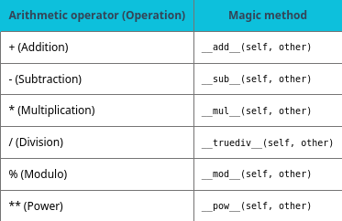
Table 11.1 Arithmetic operators and magic methods.

Slide 16
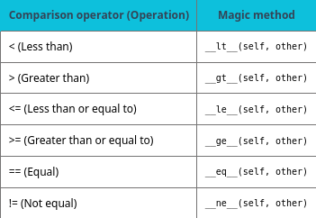
Table 11.2 Comparison operators and magic methods.

Slide 17
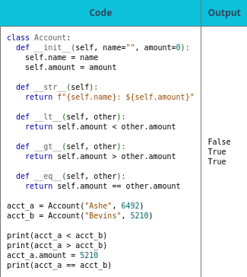
Table 11.3

Slide 18
11.5 Using modules with classes
Learning Objectives
Construct an import statement that selectively imports classes.
Create an alias to import a module.

Slide 19
11.5 Using modules with classes
Importing classes from modules
Import statements, as discussed in the Modules chapter, allow code from other files, including classes, to be imported into a program.
Accessing an imported class depends on whether the whole module is imported or only selected parts.
Multiple classes can be grouped in a module.
For good organization, classes should be grouped in a module only if the grouping enables module reuse, as a key benefit of modules is reusability.

Slide 20
11.5 Using modules with classes
Using aliases
Aliasing allows the programmer to use an alternative name for imported items.
Ex: import triangle as tri allows the program to refer to the triangle module as tri. Aliasing is useful to avoid name collisions but should be used carefully to avoid confusion.

Slide 21
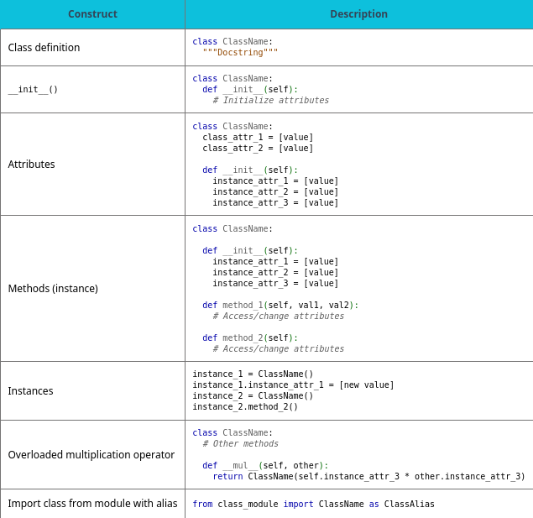
Table 11.4 Chapter 11 reference.

Slide 22
This ancillary resource is licensed under a Creative Commons Attribution-NonCommercial-ShareAlike 4.0 (CC BY NC-SA) license; it may be distributed, remixed, built upon for noncommercial purposes only, and must be attributed to OpenStax and redistributed under the same license.

